Slide 1

HR ANALYTICS CASE STUDY PROBABILITY OF ATTRITION
Group Name : Best Riders
Member name – Anuj Arya
Member name – Asim Pattnaik
Member name – Mohammed Suhail Y
Member name – Rakesh Bosu

Slide 2

Problem Statement
A large company named XYZ, employs, at any given point of time, around 4000 employees. However, every year, around 15% of its employees leave the company and need to be replaced with the talent pool available in the job market. The management believes that this level of attrition (employees leaving, either on their own or because they got fired) is bad for the company
AIM:
Required to model the probability of attrition using a logistic regression. The results thus obtained will be used by the management to understand what changes they should make to their workplace, in order to get most of their employees to stay.

Slide 3

CRISM-DM Modeling
Understanding the Octives or desired results
Reviewing the available raw data present in the data file
Replacing all incompatible characters and converting some information to the required format in the above files
Selecting CRISP-DM model to analyze the data and get the desired result
Evaluating the selected model for it’s effectiveness Applying the selected model in analysis to get the desired result

Slide 4

Data Exploration
4410 employees records with following information
General data (Age, Gender, Income, Experience,Attrition etc.)
Employee survey about environment & job satisfaction, work life balance
Manager survey about job involvement & performance rating.
Employees in-time and out-time data
Continuous Variables :
Age
DistanceFromHome
EmployeeCount
MonthlyIncome
NumCompaniesWorked
PercentSalaryHike
StandardHours
TotalWorkingYears
TrainingTimesLastYear
YearsAtCompany,
YearsSinceLastPromotion
YearsWithCurrManager

Slide 5
Data Exploration
Ordered Categorical Variables:
Education
JobLevel
MaritalStatus
StockOptionLevel
EnvironmentSatisfaction
JobSatisfaction
WorkLifeBalance
JobInvolvement
PerformanceRating
Unordered Categorical Variables:
BusinessTravel
Department
EducationField
Gender
JobRole
Over18

Slide 6
Data Preparation and Processing
Missing Values:
Replaced missing values in below columns with Median
EnvironmentSatisfaction
JobSatisfaction
WorkLifeBalance
Replaced missing values in “NumCompaniesWorked” with “TotalWorkingYears” with Mean Values
Removed outliers in below columns based on quantile function
TotalWorkingYears
YearsAtCompany
YearsWithCurrManager
Derived new metrics(Average Office Hours and Leave Count) based on employee In and Out time data.
Scaled continuous variables and created dummy variables for categorical variables for modelling
In and Out Time:
Leave Count : Calculate the number of hours that the person was on leave (excluding public holidays)
Average office hours: Calculate the hours spent by employee in office check and if it is greater than
8 hours.

Slide 7
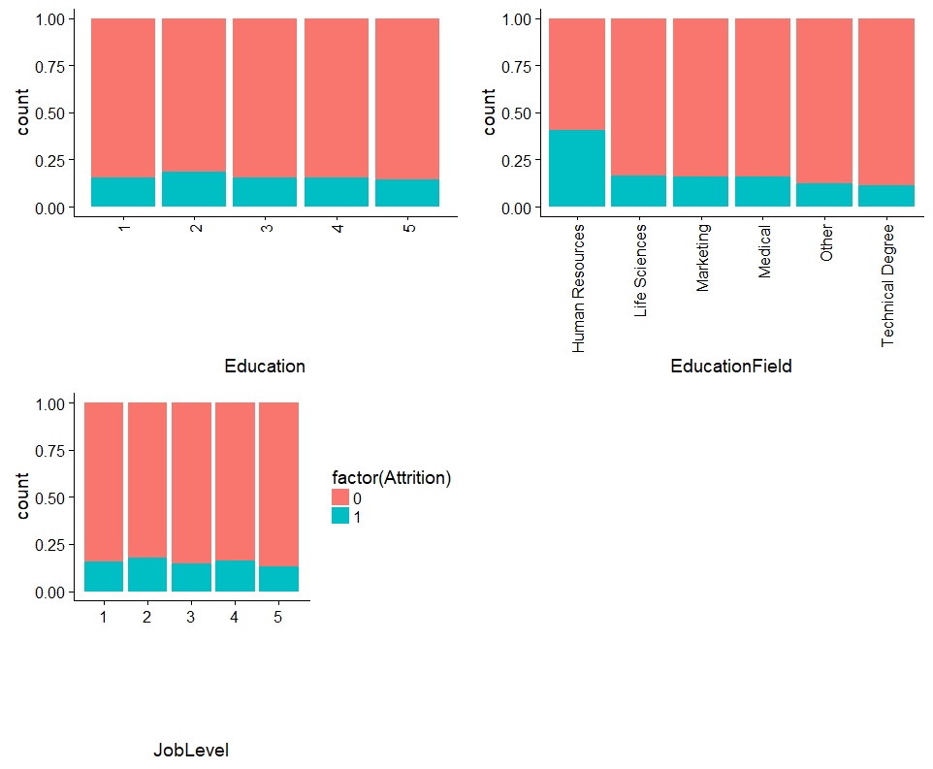
Data Analysis
Comparing Education, Education Field and Job Level
Higher Attrition is found among
Education 2
Education Filed -Human Resource
Job level 2

Slide 8
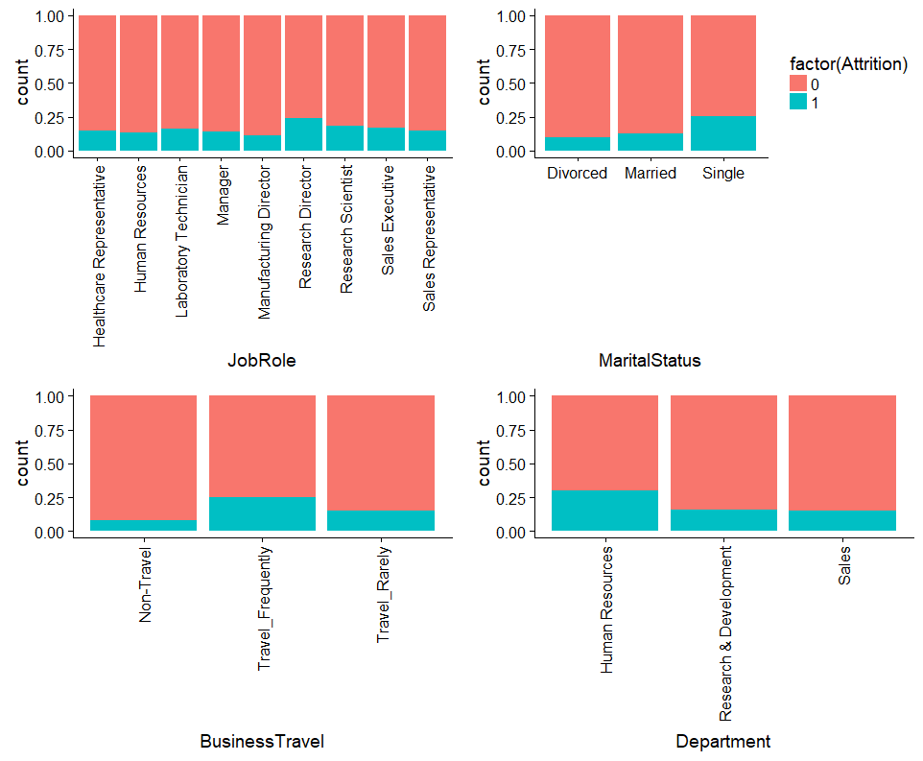
Data Analysis
Comparing Jobrole, Marital status, Business travel and Department
Higher Attrition is found among
Job roles with Research Director
Marital status - Single
Employees with Business travel
HR Department

Slide 9
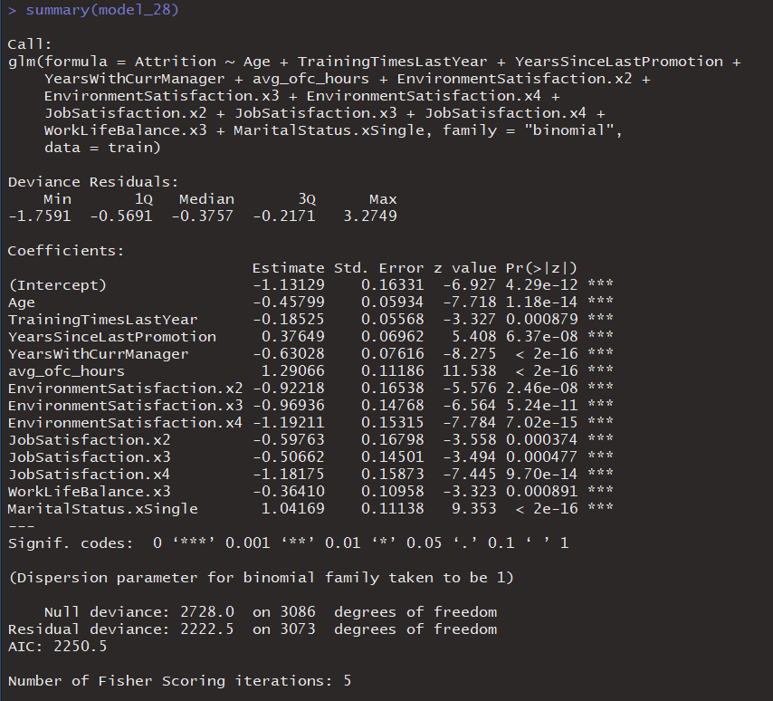
Final Model - Predictor Variables

Slide 10
Model Evaluation (Cut Off- 50%)
Probability cut off at 50%:
Accuracy of the model - 85%
Sensitivity (True Positive Rate) - 22%
Specificity (True Negative Rate) - 98%
Analysis:
o Even though the accuracy of the model is high, the sensitivity of the model is very low. Since we need Attrition rate, we need to maximize the sensitivity of the model.
 | Predicted Attrition
Actual Attrition |  | No | Yes
 | No | 1080 | 30
 | Yes | 159 | 54

Slide 11
Model Evaluation (Cut Off- 40%)
Probability cut off at 40%:
Accuracy of the model - 85%
Sensitivity (True Positive Rate) - 31%
Specificity (True Negative Rate) - 95%
Analysis:
o Though Sensitivity has increased, it’s still low.
 | Predicted Attrition
Actual Attrition |  | No | Yes
 | No | 1063 | 47
 | Yes | 145 | 68

Slide 12
Model Evaluation (Optimal Cut Off)
Based on analysis, the optimal Cut Off value is 15.36%
At Optimal Cut Off:
Accuracy of the model - 74%
Sensitivity (True Positive Rate) - 75%
Specificity (True Negative Rate) - 74%
Analysis:
o We get a high sensitivity rate of 75%
 | Predicted Attrition
Actual Attrition |  | No | Yes
 | No | 818 | 292
 | Yes | 52 | 161

Slide 13
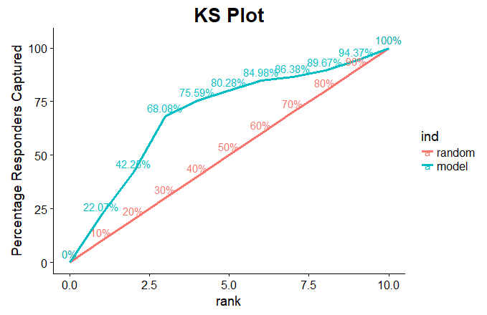
Model Evaluation – KS Statistic
KS Test measures to check whether model is able to separate events and non-events. In our model, it checks whether the our model is able to distinguish between employees who will leave and employee who won’t leave.
Ideally, the KS score lies between 40 and 70. In this case, KS score > 40 (i.e. 49.2%), which is good model.

Slide 14
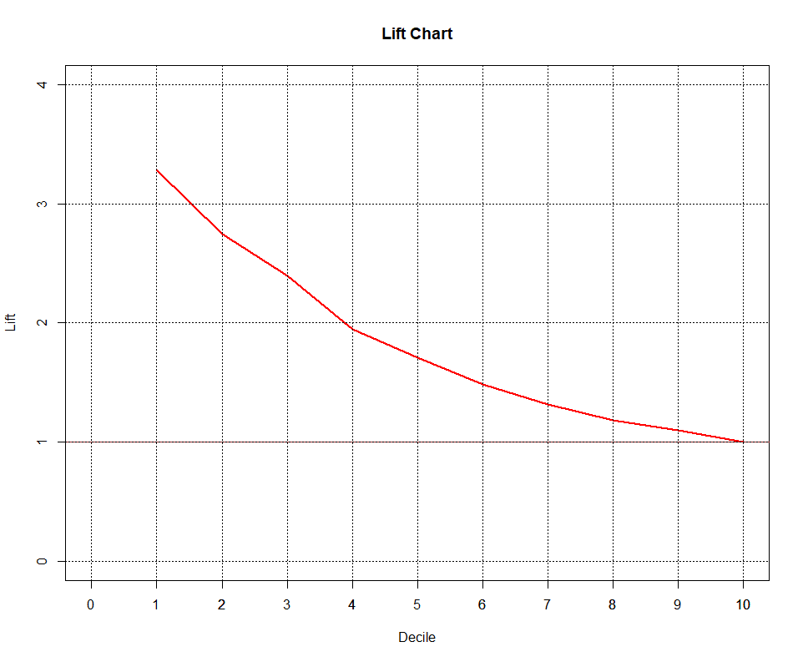
Model Evaluation – Lift And Gain
Lift Chart: Based on lift chart, we identified our model is outperforming a random model. We can predict true positive rate more efficiently using our model compared to a random model.
Gain Chart: Based on gain chart, we identified our model is performing well as shown by KS Statistic chart.

Slide 15
Conclusion
Based on the Logistic Regression model, the following attributes have been identified as key factors
that contribute to the high attrition rate of employees and could help the management to take
appropriate actions to reduce attrition rate
Age - Younger employees have high risk of leaving
TrainingTimesLastYear - More trainings, then employee tends to stay
Years Since Last Promotion - More frequent promotions, then employee tends to stay
Years with Current manager - The higher the number of years with same manager, then employee tends to stay
Environment Satisfaction - The higher, the lesser chances of leaving
Job Satisfaction - The higher, the lesser chances of leaving
Work life balance - The higher, the lesser chances of leaving
Average working hours - The higher the employee works above 8 hours, the higher chances are of him leaving
Marital status single - Single Employees have higher chances of leaving the company.

